Slide 1
PROJECT TITLE
TSP- AI ML Fundamentals (Capstone Project)
Presented By:
Student Name – Archana V
Naan mudhalvan ID- au810021114009
Guided By: Ramar Bose

Slide 2
OUTLINE
Problem Statement (Should not include solution)
Proposed System/Solution
Algorithm & Deployment
GitHub Link
Project Demo(photos / videos)
Conclusion
Future Scope
References

Slide 3
Problem Statement
Cardiovascular diseases (CVDs) represent a significant global health challenge, accounting for a substantial portion of preventable deaths and healthcare expenditures. Despite advances in medical science and public health initiatives, identifying individuals at high risk of developing CVD remains a complex and critical task. The problem statement for cardiovascular heart disease prediction revolves around developing accurate and reliable predictive models that can effectively assess an individual’s risk of developing CVD based on various demographic, clinical, and lifestyle factors.

Slide 4
Proposed Solution
The challenges associated with cardiovascular heart disease prediction, we propose the development and implementation of an advanced predictive model using machine learning techniques. This solution aims to leverage diverse datasets and cutting-edge methodologies to enhance the accuracy, reliability, and applicability of CVD risk assessment.

Slide 5
Algorithm & Deployment
Deploying a cardiovascular disease prediction algorithm involves several key steps,from developing the predictive model to making it accessible for use in a real-world setting.

Slide 6
GitHub Link
https://github.com/sweetie4599/au810021114009

Slide 7
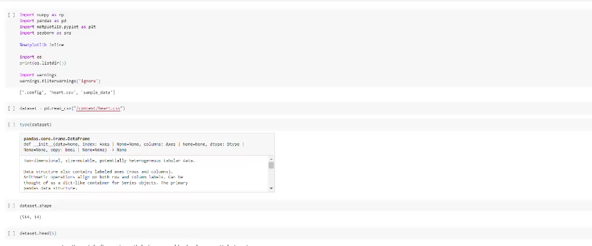
Project Demo(Recorded Video)

Slide 8
Conclusion
Cardiovascular heart disease prediction represents a pivotal area of research and with profound implications for healthcare and public health. By leveraging advanced technologies and interdisciplinary approaches, predictive models have the potential to transform cardiovascular care by enabling early risk identification, targeted interventions, and personalized treatment strategies.

Slide 9
Future Scope
Cardiovascular heart disease prediction holds immense potential for advancements in technology, healthcare delivery, and public health initiatives.The future scope of cardiovascular heart disease prediction is characterized by innovation, interdisciplinary collaboration, and a patient-centered approach to cardiovascular health management. By harnessing the power of data-driven technologies and advancing precision medicine principles, we can pave the way for more effective prevention, early intervention, and personalized treatment strategies to reduce the global burden of cardiovascular diseases.

Slide 10
References
Project Github link, Ramar Bose , 2024
Project video recorded link (youtube/github), Ramar Bose , 2024
Project PPT & Report github link, Ramar Bose , 2024

Slide 11
THANK YOU

